Slide 1
Drug Screening Practical
Designed by Molly Carlier
School of Medicine, Medical Science and Nutrition
University of Aberdeen
molly.carlier@abdn.ac.uk

Slide 2
Drug screening in drug discovery
The drug discovery process involves narrowing down which drug or formulation to take forward into the next stage of drug development
The physical and biochemical of several drugs are compared, and those showing advantageous properties are taken forward to the next stage
How is this done? By screening drugs!
Today you are going to test the properties of four drugs.

Slide 3
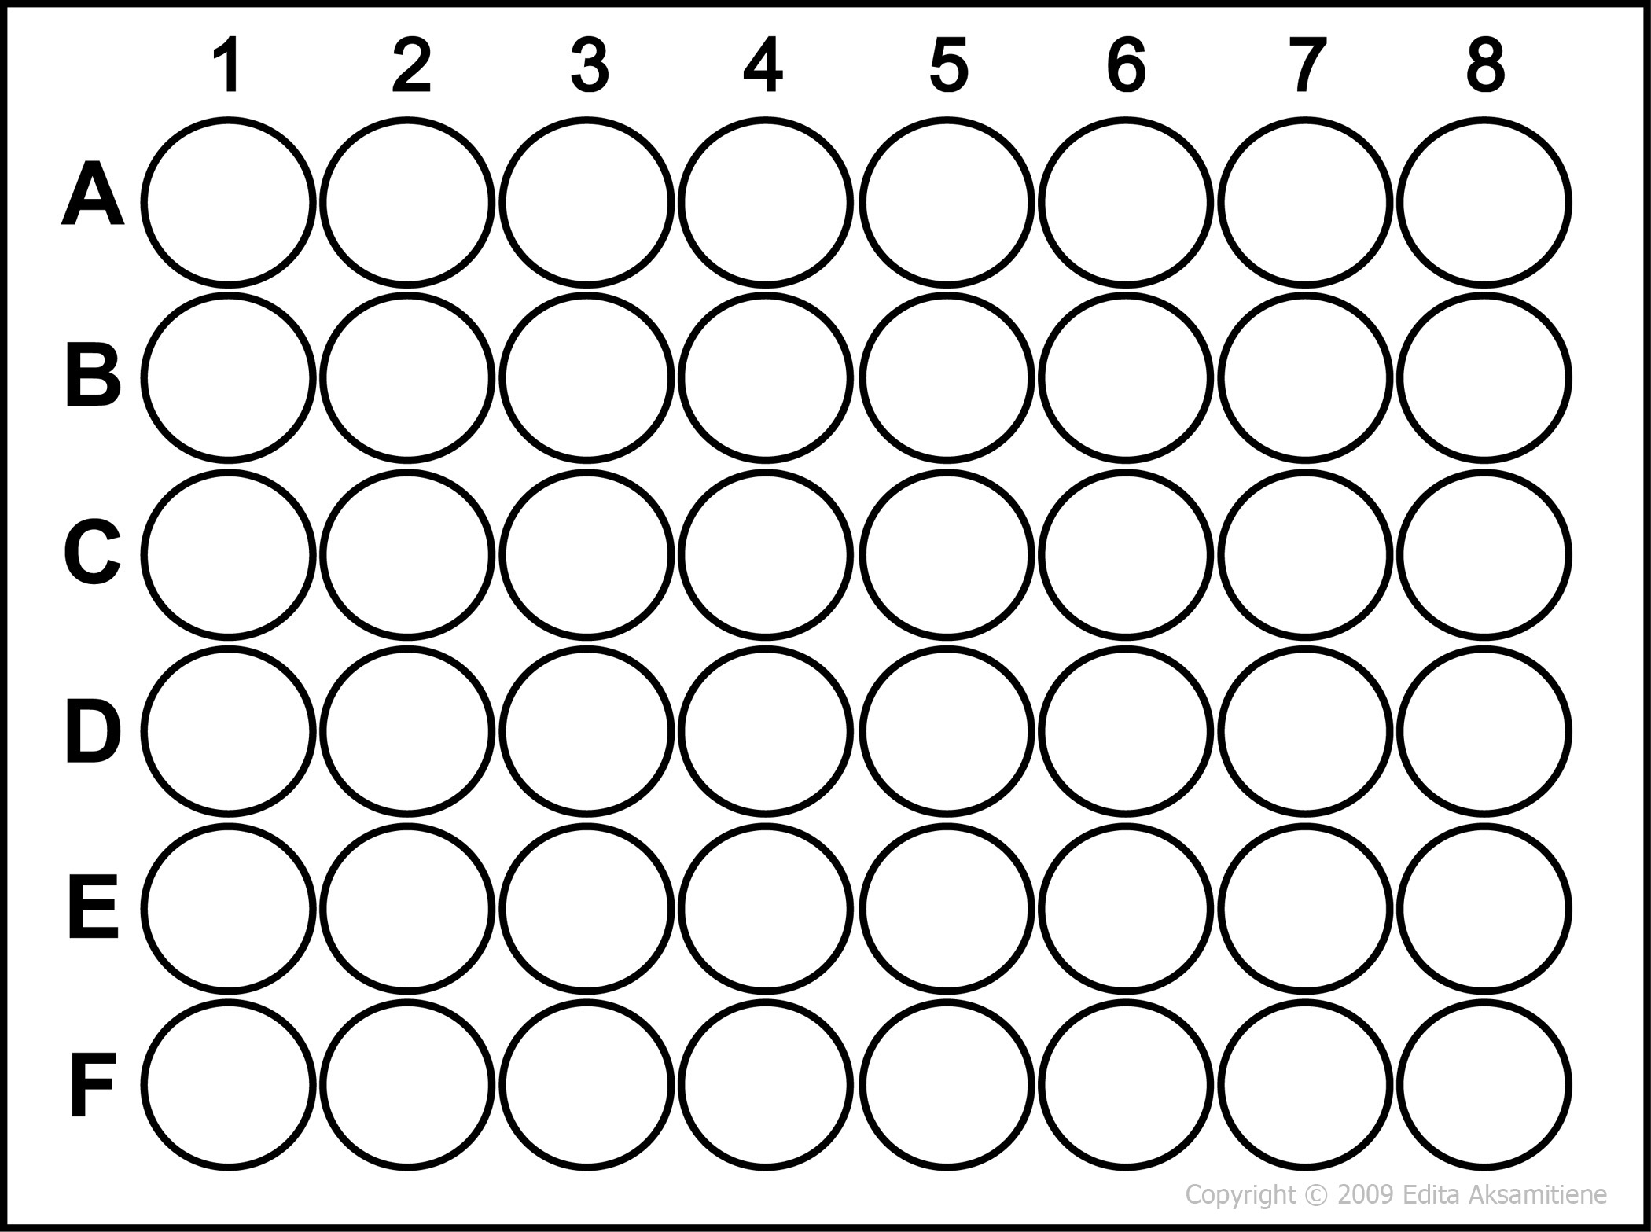
Set up drug screening plate:
Add a few granules of powdered drug #1 to wells 1 to 6 of row A
Repeat the procedure using the three other drugs so that the plate is set up accordingly
Keep the remaining powdered drug in a test tube
Drug 1
Drug 1
Drug 1
Drug 1
Drug 1
Drug 1
Drug 2
Drug 2
Drug 2
Drug 2
Drug 2
Drug 2
Drug 3
Drug 3
Drug 3
Drug 3
Drug 3
Drug 3
Drug 4
Drug 4
Drug 4
Drug 4
Drug 4
Drug 4

Slide 4
Analysis of results
Using the information you have collected in the table above, consider the properties of each drug and what this biochemical information means. These drugs are being considered as antacids; chemicals that relieve indigestion by neutralising excess stomach acid.
Compare the pH of the antacids before adding HCl, then compare the pH of antacids after adding HCl.
Which antacid seems to be most effective? Explain why.
More info in background section…

Slide 5
Report
Your task is to write a report describing the investigation you have just performed.
Scientific reports are divided into the following sections:
Introduction – introduce reader to subject including; what has been done before, what the gap in the knowledge is, what are you trying to find out in this experiment?
Method – describe how you have performed the experiment, including details!
Results – present data collected (as a table or figure)
Discussion – what do your results mean? Consider the analysis on the previous slide, and what recommendations would you make going forward? What experiments would be useful to perform in the future?

