Slide 1
DNA extraction activity
Hi! I am ___
I am a scientist
Today we are going to do some experiments
They will teach you lots about your very own cells and DNA

Slide 2
What is a cell?
Notes:
Cell is the smallest unit of living matter that can exist by itself
Some tiny organisms such as bacteria or yest consist of one single cell, but we as humans are made up of many billions of cells.
And we’re made up of several different types of cell – heart, brain, skin. And when several different types of cell come together to form a structure with a specific function this is called a tissue, and when several tissues come together they form an organ and when several organs come together they form an organism.

Slide 3
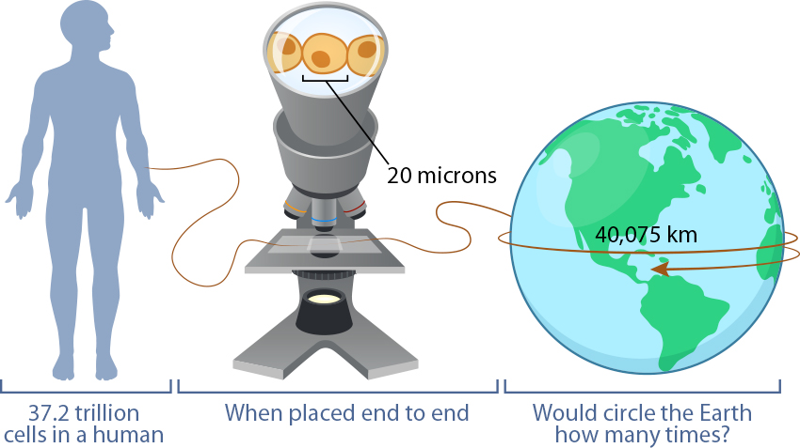
We have lots of cells!
18.5 times!!
Notes:
We are made up of several trillion cells – in fact each human is made of 37.2 trillion cells and to get some sort of scale for how much that is, if you placed each cell, which is 20microns wide, how many times do you think it would circle the earth? 18.5 times!

Slide 4
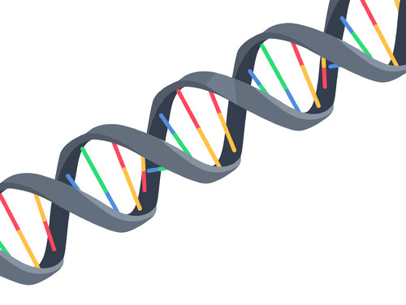
How do cells know what to do?
All cells are different……..
Each cell is told what to do by its DNA
DNA is a coiled molecule that contains a code which provides instructions for cells to follow
It tells them whether to be a muscle cell, a bone cell, a skin cell, or another type of cell
All our cells have DNA, and we all have our very own specific DNA code → that’s why we are all so different

Slide 5
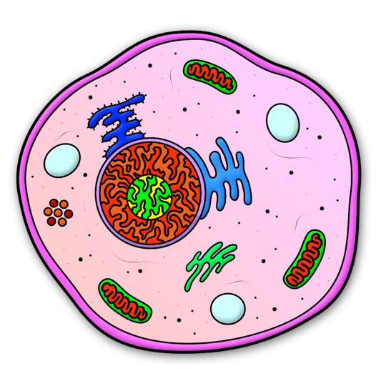
DNA
Where is DNA found?

Slide 6
DNA
Washing up liquid?

Slide 7
DNA
Laundry liquid?
DNA

Slide 8
Instructions
Wash your mouth vigorously for 2 min using the 5 ml of water in the cup. Try and bite your cheeks while doing this to help shed cells into the water. Don’t bite too hard – we don’t want any blood, and don’t swallow as we need you to carefully spit the solution into the test tube with the orange cap.
Add 2 drops of detergent to the test tube, screw the cap on and invert it slowly 8 times.
Add 5 drops of enzyme to the test tube, screw the cap on and invert it slowly 8 times.
Wait 5 min.
The instructor will come round and run some ice-cold alcohol down the side of the tube so it forms a layer on top of your cell mixture. Put the lid on and let it sit for 5 min. Watch for white wisps forming at the interface between the alcohol and the cell solution. This is your DNA!
After 5 min, invert the tube a couple of times (VERY GENTLY) to clump the DNA together and use a pipette to transfer the DNA and some of the liquid into the small glass bottle. Place the lid securely on, and you now have a sample of your own DNA to keep!

